Slide 1
BIT 245
RDBMS With SQL
Sushil Bhattarai
sushil.bhattarai@texascollege.edu.np
Lincoln University College, CN 1221

Slide 2
Relational databases

Slide 3
Early Data Models
File Management Systems :
Size
Is huge data supported?
Accuracy
Are there chances of entering incorrect data?
Security
Should the data be visible to everyone who access the file?
Redundancy
Is data repeated?
Inconsistency
Is data same on each copies?
Importance
computer crashes…?
Atomicity
Transaction should either happen or do not happen at all.
Reports
Automation

Slide 4
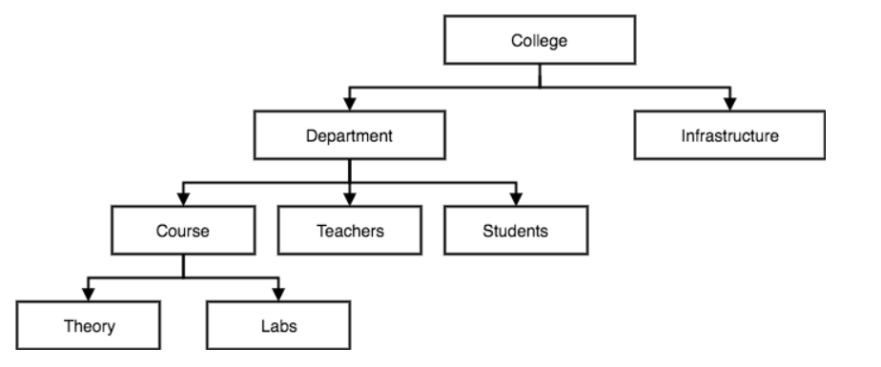
Early Data Models
Hierarchical Databases :
Organizes data into a tree-like-structure, with a single root
Hierarchy starts from the Root data, and expands like a tree, adding child nodes to the parent nodes
A child node will only have a single parent node
Data is organized with one one-to-many relationship between two different types of data

Slide 5
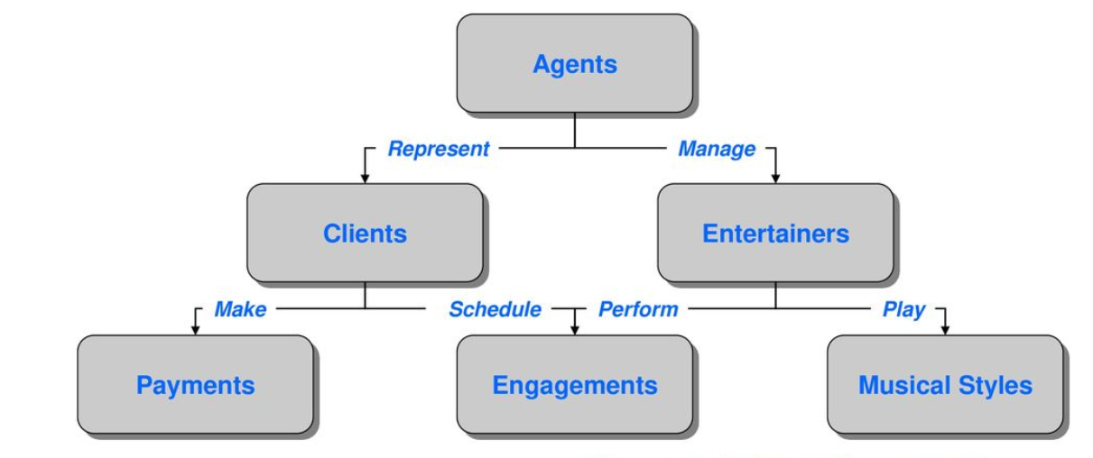
Early Data Models
Network Databases :
Data is organized more like a graph, and have more than one parent node
Accessing the data is also easier and fast as data can be related from multiple nodes
Maps many-to-many data relationships

Slide 6
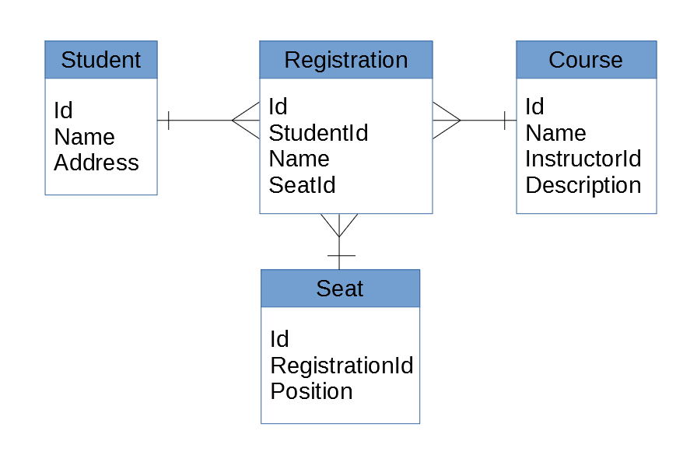
The Relational Data Model
Relationships are created by dividing data into entity and attributes
Relationship is maintained by storing a common field
Information related to a particular type is stored in rows of a table
Simpler than the hierarchical and network model
High performance

Slide 7
Codd’s 12 Rules for Relational Databases
Dr Edgar F. Codd, after his extensive research on the Relational Model of database systems, came up with twelve rules of his own, which according to him, a database must obey in order to be regarded as a true relational database. These rules can be applied on any database system that manages stored data using only its relational capabilities. This is a foundation rule, which acts as a base for all the other rules.
Rule 1: Information Rule
The data stored in a database, may it be user data or metadata, must be a value of some table cell. Everything in a database must be stored in a table format.
Rule 2: Guaranteed Access Rule
Every single data element (value) is guaranteed to be accessible logically with a combination of table-name, primary-key (row value), and attribute-name (column value). No other means, such as pointers, can be used to access data.
Rule 3: Systematic Treatment of NULL Values
The NULL values in a database must be given a systematic and uniform treatment. This is a very important rule because a NULL can be interpreted as one the following − data is missing, data is not known, or data is not applicable.
Rule 4: Active Online Catalog
The structure description of the entire database must be stored in an online catalog, known as data dictionary, which can be accessed by authorized users. Users can use the same query language to access the catalog which they use to access the database itself.
Rule 5: Comprehensive Data Sub-Language Rule
A database can only be accessed using a language having linear syntax that supports data definition, data manipulation, and transaction management operations. This language can be used directly or by means of some application.

Slide 8
Codd’s 12 Rules for Relational Databases(Contd…)
Rule 6: View Updating Rule
All the views of a database, which can theoretically be updated, must also be updatable by the system.
Rule 7: High-Level Insert, Update, and Delete Rule
A database must support high-level insertion, updation, and deletion. This must not be limited to a single row, that is, it must also support union, intersection and minus operations to yield sets of data records.
Rule 8: Physical Data Independence
The data stored in a database must be independent of the applications that access the database. Any change in the physical structure of a database must not have any impact on how the data is being accessed by external applications.
Rule 9: Logical Data Independence
The logical data in a database must be independent of its user’s view (application). Any change in logical data must not affect the applications using it. For example, if two tables are merged or one is split into two different tables, there should be no impact or change on the user application. This is one of the most difficult rule to apply.
Rule 10: Integrity Independence
A database must be independent of the application that uses it. All its integrity constraints can be independently modified without the need of any change in the application. This rule makes a database independent of the front-end application and its interface.
Rule 11: Distribution Independence
The end-user must not be able to see that the data is distributed over various locations. Users should always get the impression that the data is located at one site only. This rule has been regarded as the foundation of distributed database systems.
Rule 12: Non-Subversion Rule
If a system has an interface that provides access to low-level records, then the interface must not be able to subvert the system and bypass security and integrity constraints.

